Slide 1

















AFL'15 - Sentiment Analysis & Predictions
Debojyoti Saha - 614338
Prasanna Kumar Ravi - 667912

Slide 2
Project Walkthrough
Objective – To provide Sentiment Analysis on AFL-2015
Motivation – Technology, Means, Results & The Audience
Steps Involved :
Harvesting Tweets
Storage
Sentiment Analysis
User Interface
Challenges Faced
Results Obtained
Future Directions

Slide 3
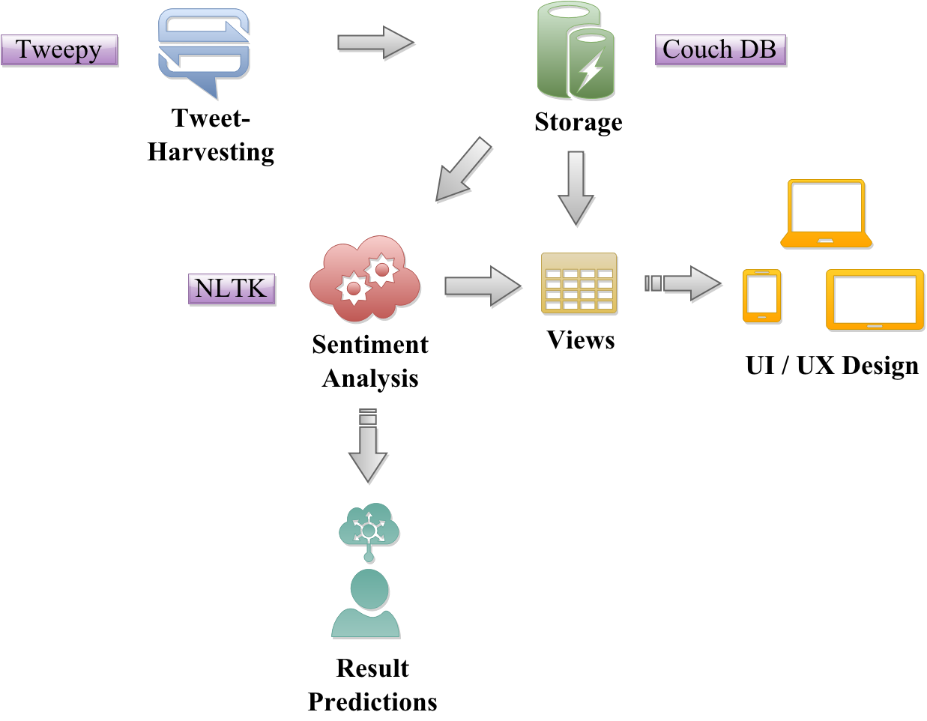
System-Design

Slide 4
Why Twitter?
Short message format - preferred by everyone.
Amount of Data – Surplus, I mean people just don’t stop tweeting !
Availability – Can be tapped into easily.
Libraries Used.
API Methods.

Slide 5
Harvesting Tweets !
STREAMING
SEARCH
Slower retrieval rate
Limited to 1% of the data
Less possibility of maxed retrieval
Produces new tweets on repeated runs
Forward querying
Rate Limits based on retrieval quantity
Single open connection
Retrieves more tweets in short time
No limitation on retrieval
More calls and more results
Different runs produce the same tweets
Back-filling
Rate Limits based on no. of calls made
Multiple connections on same account

Slide 6
Challenges Faced
Geo Location – Streaming & Search
Stream – Location & Radius
OR’d conditions
Search – Bounding Boxes
Trivial Results
Search – No Saves
Produces Duplicates on repeated runs
APIs – Toppssy, TwitterSearch
Search API – Keywords processed one at a time
Rate Limits – 180 calls with 100 rpp every 15mins
Wait_On_Rate_Limit
Tag clouds for relevant tweets
Tweet formatting & Storage – Removing Duplicates
Combination of methods for better Results

Slide 7
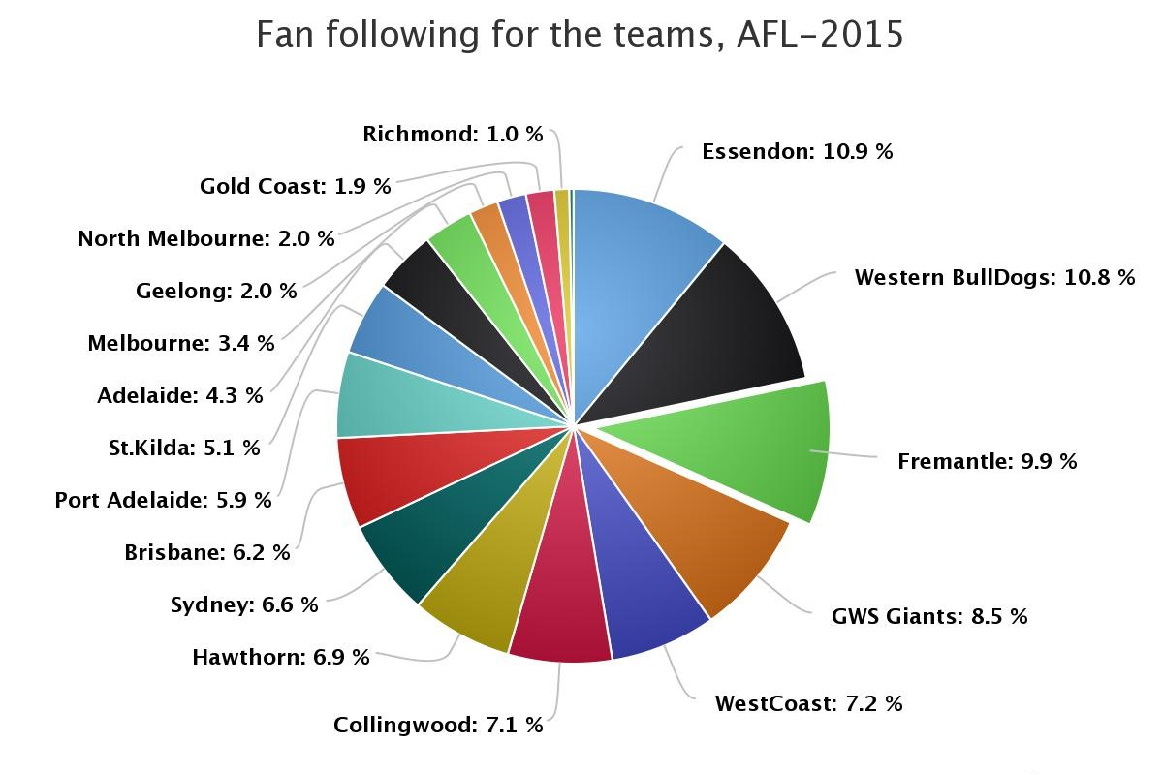
Findings & Observations
Supporters for each team during the match
Most Popular/Trending Tweets for the match
E.g: Collingwood Vs. Geelong :
@jhutch1992: Incredible season. nothing but love for the cats #GoCats #BBN
@DHughesy: Melbourne Victory have more goals on the board than Collingwood. #FunFactFriday #MelbDerby #AFLPiesCats
Tag Cloud – popular tags
Most talked about players
Devices Used(E.g: iOS,Android,WebClient etc.)
League Table Positions
Tweet Classifications
Tweets ∝ Match Attendance

Slide 8
Sentiment Analysis
Term frequency based or Syntactical Probability based
Manually classified tweets
Term Frequency based
Aggregate the number of negative and positive terms in Key word List
Predict based on aggregate
Accuracy 50.12%
Semantic Based
Manually classified tweets based on sentiment.
Predict using Supervised Learning
Best Accuracy 85.82% (SVM)
NaïveBayes Classifier / Support Vector Machine

Slide 9
Prediction Based on Sentiment
Classifier biased towards a sentiment class, more towards “Negative”.
To find out a sentiment is absolutely positive
Based on observations
Factors of Decision making :
Net Ratio of (Negative/ Positive) tweets - How many negative tweets per Positive tweet?
Net ratio of ( Neutral/ Positive or Negative tweets) - On an Average, How many are tweets carry any sentiment
Typicality /Typicality coefficient - Typicality(t) ,is assessed based on Net ratio of tweets at any given time. Typicality Coefficient in expressed in terms of |log(t)|.

Slide 10
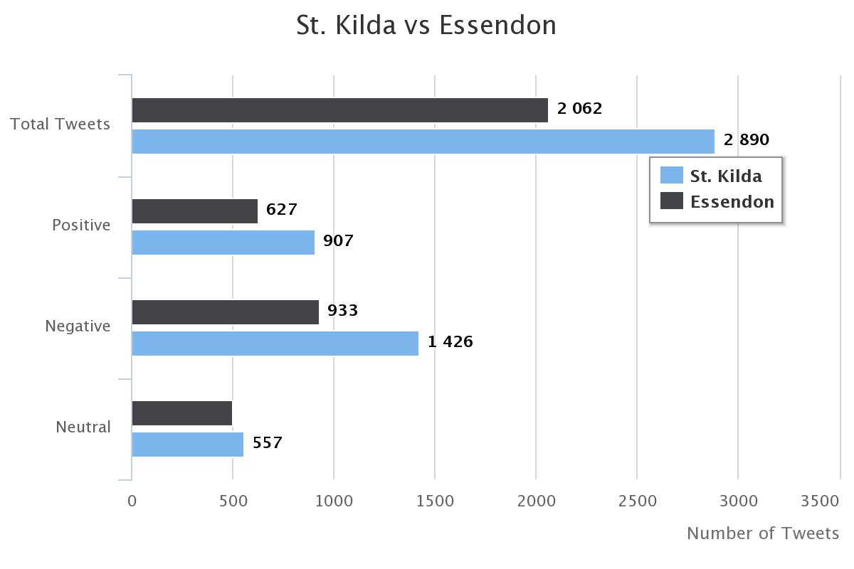
Results and Inferences
Which team won the contest?
Essendon - 1.488 net(N/P) ratio
St Kilda - 1.572 net(N/P) ratio
Score margin?
Low Margin

Slide 11
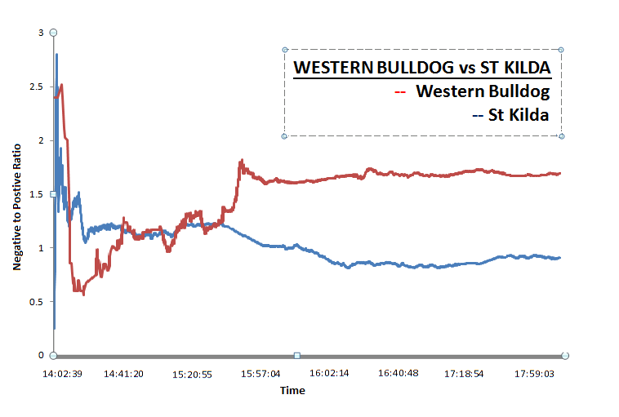
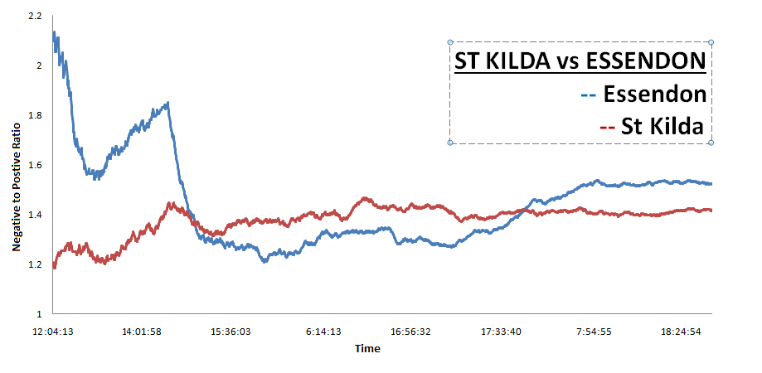
Results and Inferences (contd..)
Contest Type ?
St Kilda Vs. Essendon :
Average Contest
WesternBulldog Vs. St Kilda:
Great Contest
Most probable team?
Tippers choice -Bulldogs 93.0% and Saints 7.0%

Slide 12
Challenges
Classifier Training / Feature Selection
Making the Prediction model
Biased the classifier to negative
Observations :- tweet types – Positive , Negative, Neutral and Sarcasm ( a negative positive)!!
Weka or NLTK
Graphs and Interpretation

Slide 13
Conclusion
Tweet sentiments correlate with the outcome of the contest.
Other Twitter Metadata in conjunction with Twitter sentiment can provide deeper insights.
Accuracy and scope of inferences are heavily depended on the number of tweets .

Slide 14
References
Bennett, P.N.: Assessing the calibration of Naive Bayes’ posterior estimates. Technical Report No. CMU-CS00-155 (2000)
Blum, Avrim and Shuchi Chawla. 2001. Learning from labeled and unlabeled data using graph mincuts. In Intl. Conf. on Machine Learning (ICML), pages 19–26.
A. Agarwal and P. Bhattacharyya, "Sentiment analysis: A new approach for effective use of linguistic knowledge and exploiting similarities in a set of documents to be classified," in Proceedings of the International Conference on Natural Language Processing (ICON), 2005.
Twitter< https://dev.twitter.com/overview/documentation>
Naïve Bayes Classifier - <http://www.nltk.org/_modules/nltk/classify/naivebayes.html>
SVM - <http://www.nltk.org/_modules/nltk/classify/svm.html>

Slide 15
Thank You!!

